Slide 1
Customer review sentiment analysis report
Insights obtained from the customer review data for British airlines

Slide 2
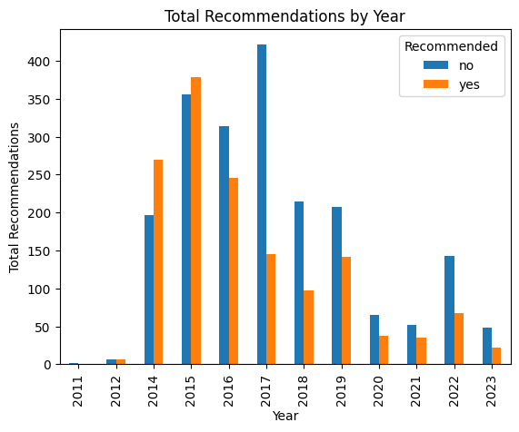
Decline in number of Recommendation by customer per year after 2016

